Slide 1
DESIGN, DEVELOPMENT, HOSTING AND MAINTENANCE OF PRAAPTI WEB PORTAL and MOBILE APPLICATION Project Kick-Off Meeting
Meeting Date | 01-September-2025
Presented By | Nikhil Singh

Slide 2
Meeting Agenda
About NCM
Project Objectives
Understanding of Project Scope
Project Phase-wise Scope
Software Environment
Web Portal Development Flow
Journey Till Milestone
Approach for going forward
Project Development Plan
Deliverables
Appropriate Delegation and Accountability of stakeholders
Expected Challenges faced
Mythology We Used
Management Team Details

Slide 3







About NetCreativeMind
NetCreativeMind Solutions is prominent Information and Communication Technology (ICT) Services Provider and Solutions Company that provides the services such as E-Governance solutions, Software Accessibility, Staffing Solutions, Outsourcing Development, and OEM's Partner Products in India and abroad. It covers the Government and Public Sector at a massive scale and its software makes the organization work easy to handle.
23+ Years’
Experience
Certifications
Project Completed
Achievements
25+
25+ Countries Served
CMMI Level 3
1000+
Projects Completed
National Awards
Founded in 2002, wholly owned by NetCreativeMind Solutions Pvt Ltd
ISO 9001 – 2015 Certificate
250+
Govt. Projects
Web Ratna Award
ISO 27000:2018 Certificate

Slide 4
Project Objectives
To modernize and enhance the PRAAPTI Web Portal and Mobile Application, aligning with industry best practices to ensure transparency, accountability, and efficiency in the power procurement process under the Ministry of Power, Government of India.
Core Focus Areas
Real-time monitoring & central auditing
Seamless stakeholder engagement
Robust data protection & compliance with LPS Rules, 2022
Modernized, user-friendly, and bilingual design
Scalable hosting with disaster recovery and backups

Slide 5
Key Objectives
Transparency & Compliance
Ensure invoicing & payments as per LPS Rules, 2022
Centralized invoice and payment management
User Experience
Intuitive, bilingual, responsive design
Accessibility for differently-abled users
Process Efficiency
Entity registration, invoice management, bulk uploads
Automated notifications & query redressal
Data Security & Standards
SSL encryption, role-based access, API security
Virtual firewalls & disaster recovery
STQC certification compliance
Decision Support
Dashboards for graphical data & MIS reporting
Customized reports for stakeholders
Infrastructure
Migration to MeitY-empanelled GCC
Dedicated environments (development, testing, production)
Domain mapping, backups & disaster recovery

Slide 6
Understanding of Project Scope
Functional
Web Portal & Mobile App Development
User Management
UI/UX Enhancements
Billing & Revenue Management
Centralized Query Redressal & Monitoring
MIS Reporting & Dashboards
Security & Data Protection
Database Management
API Integration (to be provided by client)
Archive Management
In-site Search Module
Admin & Content Management
Non-Functional
SSL Implementation
STQC Certification
Disaster Recovery Setup
Bilingual Support
Accessibility for Differently-abled Users
Hosting & Migration
Migration to MeitY-empanelled GCC
Domain mapping & application hosting
Backup & restore mechanisms
Security arrangements in place
Disaster recovery tested & documented
Regular environment reviews & performance reports
Maintenance & Operations : 3-year AMC with 2 manpower deployment

Slide 7
Project Phase-Wise Scope (Aligned with Milestones)
Milestone 1: Requirement Gathering & SRS
Stakeholder consultations
Requirement analysis & documentation
Submission & approval of Software Requirement Specification (SRS)
Milestone 4: Training & Go-Live Support
User training sessions for stakeholders
Handover of technical & functional documents
Successful live operations for 3 months (stabilization phase)
Milestone 2: Development & Testing
Web Portal & Mobile App development
UI/UX enhancements
Module implementation: User Management, Billing, Query Redressal, Reports
Functional & security testing
CERT-IN security audit
Milestone 5: Maintenance & Enhancements
3-year Operation & Maintenance support with manpower deployment
Ongoing maintenance, performance monitoring & bug fixes
Feature updates & enhancements as per stakeholder needs
Milestone 3: Infrastructure & Migration
Allocation of cloud infrastructure (MeitY-empanelled GCC)
Database migration from existing server
SSL implementation & security arrangements
Functionality verification of migrated portal & app

Slide 8
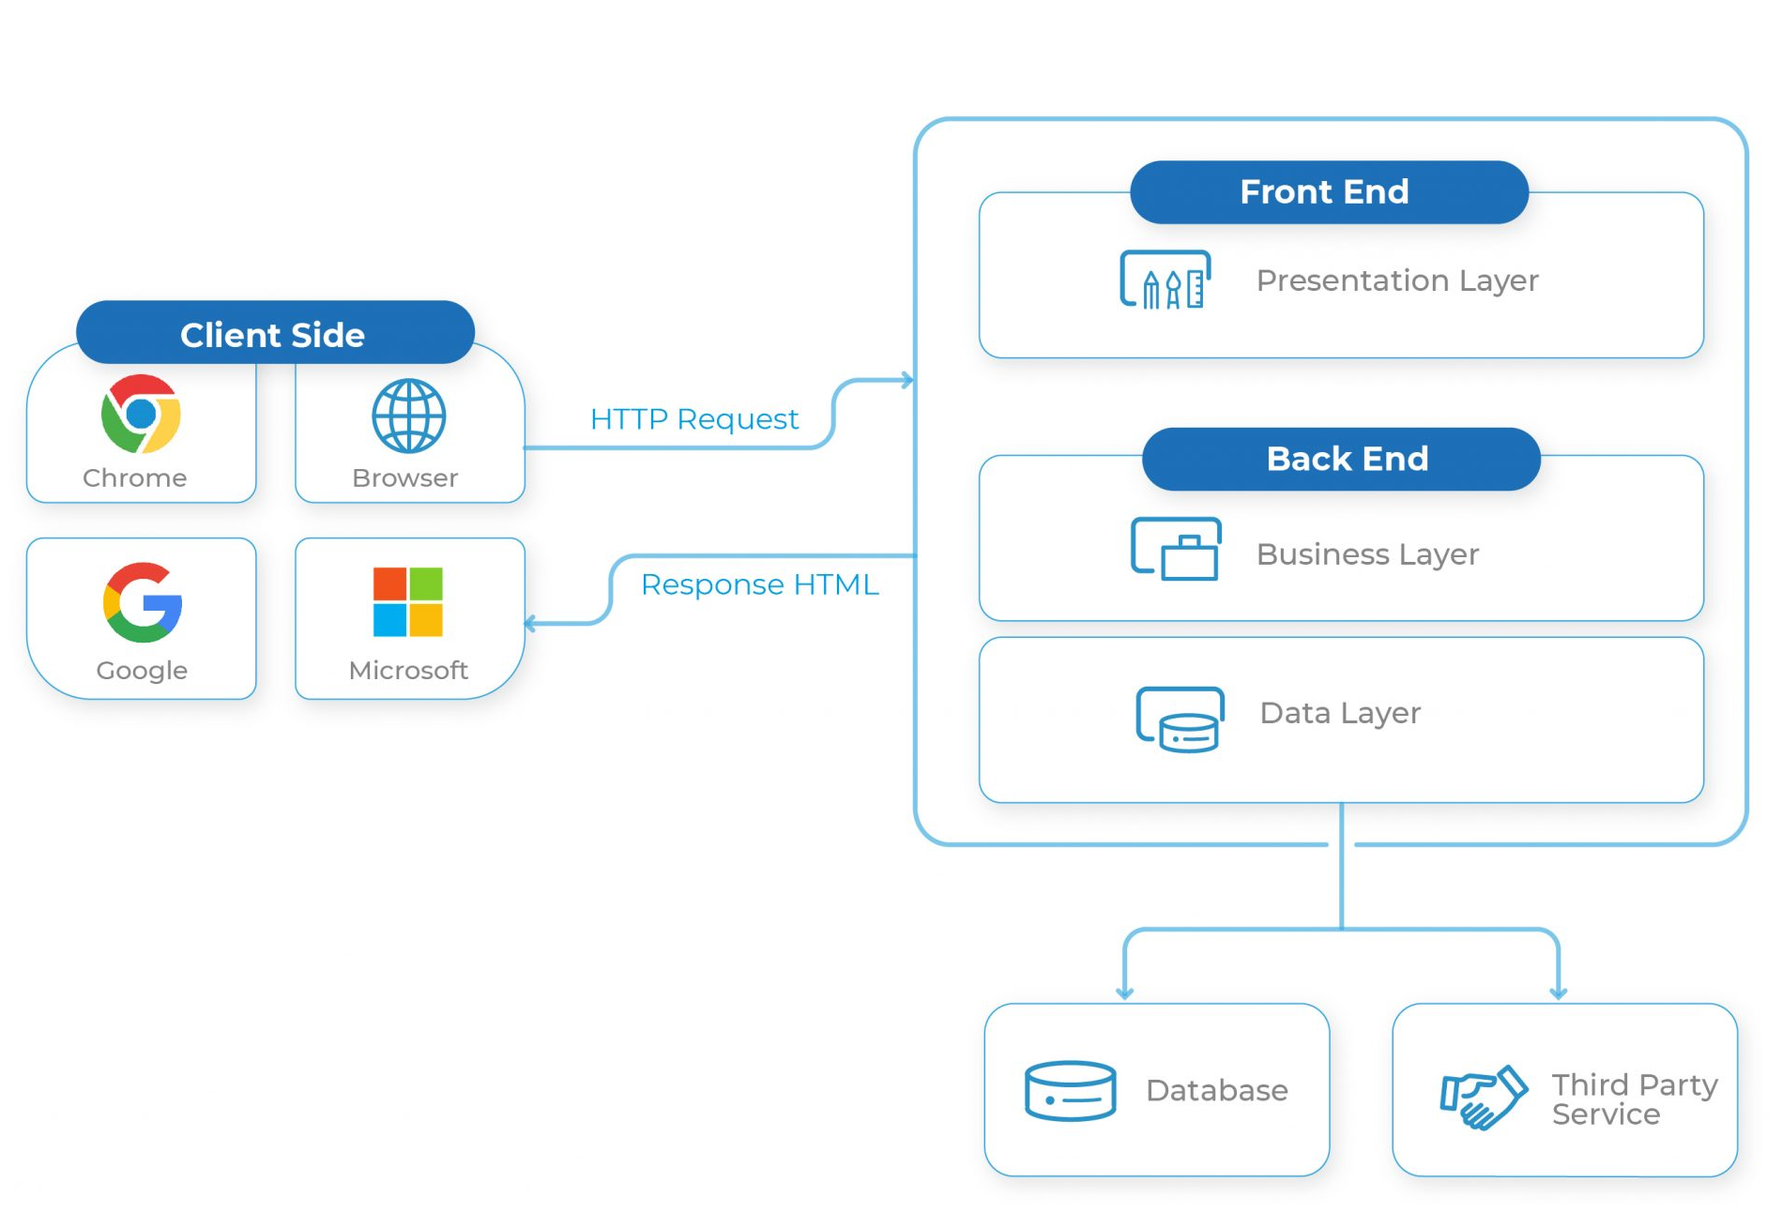
Software Environment
Operating System : UBUNTU
Mobile Application : React Native
Database : My SQL
Language : PHP Framework Laravel

Slide 9
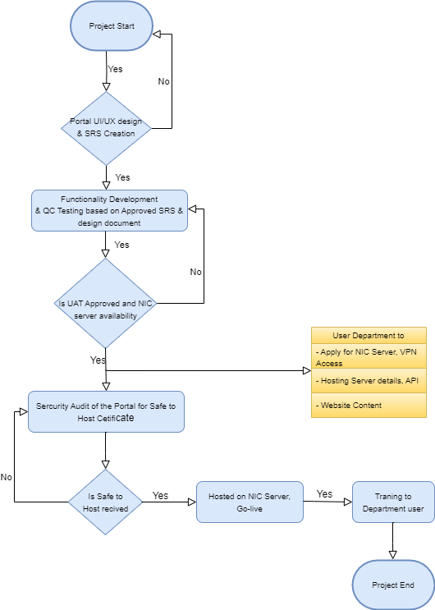
Web Portal Development Flow

Slide 10





Journey till Milestone 1 : 2 Weeks : Finalization of SRS
STAGE 01
STAGE 03
STAGE 02
STAGE 04
Requirement Gathering
SRS Preparation
SRS Review
Milestone 1 Signoff

Slide 11

Journey till Milestone 2 : 20 Weeks: Development & Testing
STAGE 01
STAGE 03
STAGE 02
STAGE 04
STAGE 05
Web Portal & Mobile Application development completed
Functional & security testing conducted
CERT-IN security audit done
Web Portal Wireframe Design
Milestone 2 Signoff

Slide 12
Journey Till Milestone 3 : 7 weeks : Infrastructure & Migration
STAGE 01
STAGE 03
STAGE 02
STAGE 04
STAGE 05
STAGE 06
PRAAPTI Portal migrated to MeitY-empanelled GCC
Database migration from old server completed
SSL certificate implemented & verified
Security arrangements tested
Demonstration
UAT Approval by Department
Milestone 3 Signoff

Slide 13
Journey till Milestone 4 (Training & Go-Live Suppor)
STAGE 01
STAGE 03
STAGE 02
STAGE 04
User training initiated
Handover documents being prepared
3-month live monitoring phase started
Milestone 4 Signoff

Slide 14
Approach for Going Forward
Web portal’s wireframe & SRS finalisation and approval by the department.
NetCreativeMind (NCM) team to create web portal design template, Wireframe and document the Software Requirement Specification (SRS) in discussion with department. Department to review and approve web Portal UI design, Wireframe and SRS.
Content compilation for each link of approved design and delivery of final content (English & Hindi ) by department as per plan.
Completion of Milestone-2, functionality development & testing by NCM team based on approved design, wireframe and SRS document.
Department to apply for NIC/GOV domain name and NIC staging/production servers, FTP & VPN, email services with SMTPS .
Milestone-3 [UAT & migration] to be performed & approved by department.
After UAT approval, Web portal will be hosted on staging server and submitted to external auditing company for security audit by NCM team. On completion of security audit, Safe to Host certificate & audit report will be issued.

Slide 15
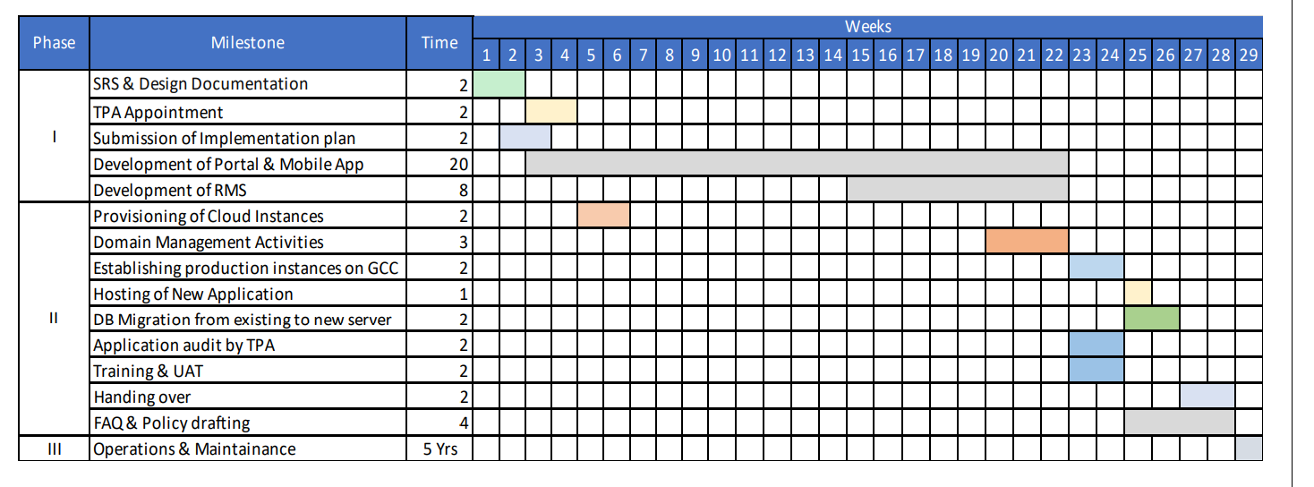
Project Development Plan

Slide 16
Deliverables
1.SRS Document
2.Detailed Project Plan, Functional Specifications and Design documents.
3.Ownership of all source code
4.Data Migration Document
5.Technical Manuals, User Manuals and Training material
6.CERT-IN Empaneled STQC audit &Functional Audit Report
7.Data Backup / Archival process
8.FAQ and web Portal & Mobile Application policy
9. Security Audit
10. SSL certificate
11. Strictly comply to all national and international copyright, IPR and trademark requirements
for all content available
12.Non-disclosure agreement
13.Training & Support
14. Disaster Recovery

Slide 17
Appropriate Delegation and
Accountability of stakeholders
Activities | NCM | Department
Nodal officer(SPOC) for Smooth Project Execution | ✓ | ✓
Preparation of all the documents like Wireframe SRS, User Manual etc. | ✓
Approval on time of the all the documents like Wireframe, SRS, User Manual etc. |  | ✓
Development of Web Portal | ✓
Facility, credentials and API for integration with 3rd party service | ✓ | ✓
Back Up | ✓
Email Service provisioning | ✓
Signoff UAT & Go-Live of the Web Portal |  | ✓
All Infra (Hardware & Software) required for hosting the application | ✓
Configuration of Application | ✓
Configuration of Database server | ✓
Application & DB Server Configuration (pre-requisites) | ✓
Network Configuration | ✓
Security & Backup | ✓ | ✓
Monitoring & Server Maintenance | ✓
Facility and credentials for Data Migration |  | ✓

Slide 18
Expected Challenges
Delay in SRS and design finalisation & approval by department. This is mainly because of difference in opinion between key decision makers and slow approval process within the department.
Rework on approved design & SRS at the time of UAT or just before going live. This happens when approvals are provided by department’s nodal officer in order to expedite the Web portal development without involving or getting approval of senior authorities during design finalisation.
On time review and approvals of various deliverables by department.
Availability of Database Schema at time of Development of Backend Structures and Tables

Slide 19
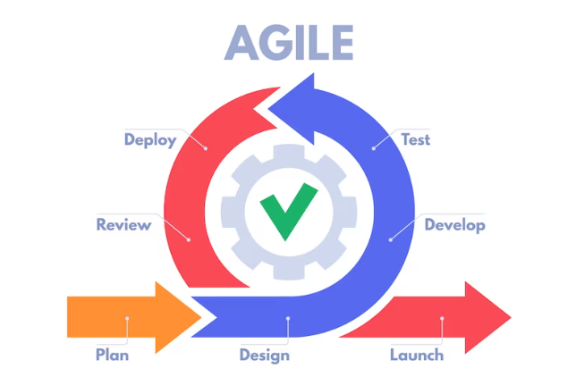
Methodology We Used
Will co-ordinate and provide timely update at every stage till launch

Slide 20
Management Team Details – NetCreativeMind
Mr. Manoj Kumar Garg [CEO]
Mobile Number : +91-9810978433
Email : manoj@netcreativemind.com
Mr. Nikhil Kumar Singh [PM]
Mobile Number : +91-9810306268
Email : nikhil.singh@netcreativemind.com
Mr. Rohit Tiwari[Sales Manager]
Mobile Number : +91-9911729706
Email : rohit.tiwari@netcreativemind.com
Mr. Mohammad Sajid [Technical Manager]
Mobile Number : +91-9654936266
Email : mohammad.sajid@netcreativemind.com

Slide 21
Thank You

